Slide 1
Decision Trees
Dr. Rashmi Mahajan

Slide 2
Decision Tree
The Decision Tree Algorithm is one such algorithm that is used to solve both Regression and Classification problems.
Decision Tree is considered to be one of the most useful Machine Learning algorithms since it can be used to solve a variety of problems.

Slide 3
Decision Tree
It is considered to be the most understandable Machine Learning algorithm and it can be easily interpreted.
It can be used for classification and regression problems.
Unlike most Machine Learning algorithms, it works effectively with non-linear data.
Constructing a Decision Tree is a very quick process since it uses only one feature per node to split the data.
SVM- Linear, Non-linear

Slide 4
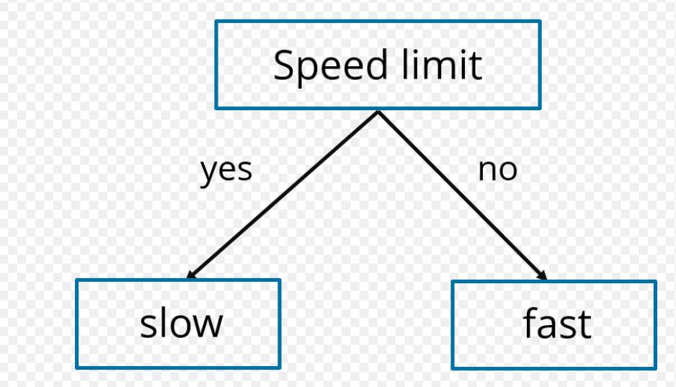
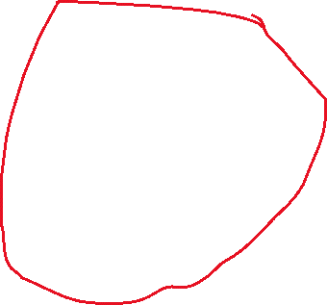







Decision Tree
Have you reached to speed limit previously

Slide 5
Decision Tree
Root Node: The root node is the starting point of a tree. At this point, the first split is performed.
Internal Nodes: Each internal node represents a decision point (predictor variable) that eventually leads to the prediction of the outcome.
Leaf/ Terminal Nodes: Leaf nodes represent the final class of the outcome and therefore they’re also called terminating nodes.
Branches: Branches are connections between nodes, they’re represented as arrows. Each branch represents a response such as yes or no.

Slide 6
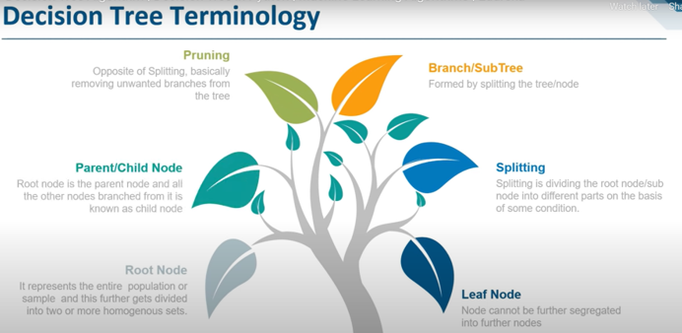
Decision Tree

Slide 7
Decision Tree
Two measures are used to decide the best attribute:
Information Gain: Information Gain (IG) is the most significant measure used to build a Decision Tree. It indicates how much “information” a particular feature/ variable gives us about the final outcome.
Entropy: Entropy measures the impurity or uncertainty present in the data. It is used to decide how a Decision Tree can split the data

Slide 8
Decision Tree
Step 1: Select the feature (predictor variable) that best classifies the data set into the desired classes and assign that feature to the root node.
Step 2: Traverse down from the root node, whilst making relevant decisions at each internal node such that each internal node best classifies the data.

Slide 9
Decision Tree
To study a Mushroom data set in order to predict whether a given mushroom is edible or poisonous to human beings.
Oder
Color
Shape

Slide 10
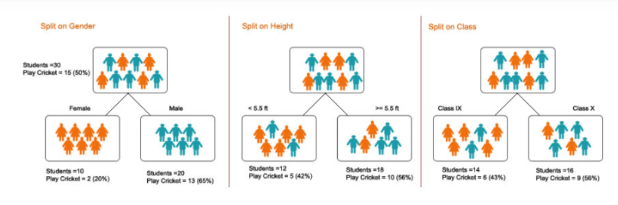
Decision Tree-Steps
There are many steps that are involved in the working of a decision tree:
1. Splitting – It is the process of the partitioning of data into subsets. Splitting can be done on various factors as shown below i.e. on a gender basis, height basis, or based on class.

Slide 11
Decision Tree-Steps
Pruning is also of two types:
Pre-Pruning – Here, we stop growing the tree when we do not find any statistically significant association between the attributes and class at any particular node.
Post-Pruning – In order to post prune, we must validate the performance of the test set model and then cut the branches that are a result of overfitting noise from the training set.

Slide 12
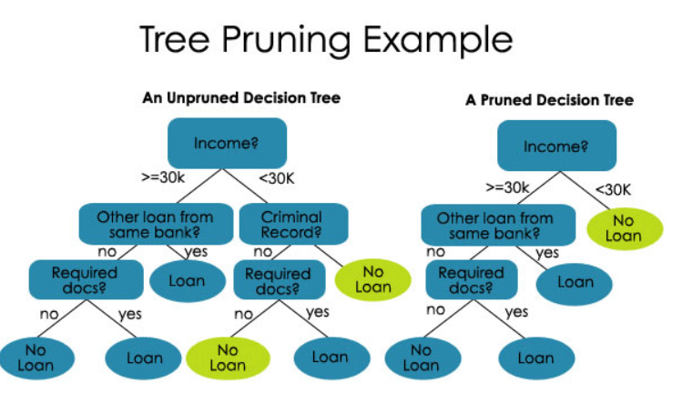
Decision Tree-Steps

Slide 13
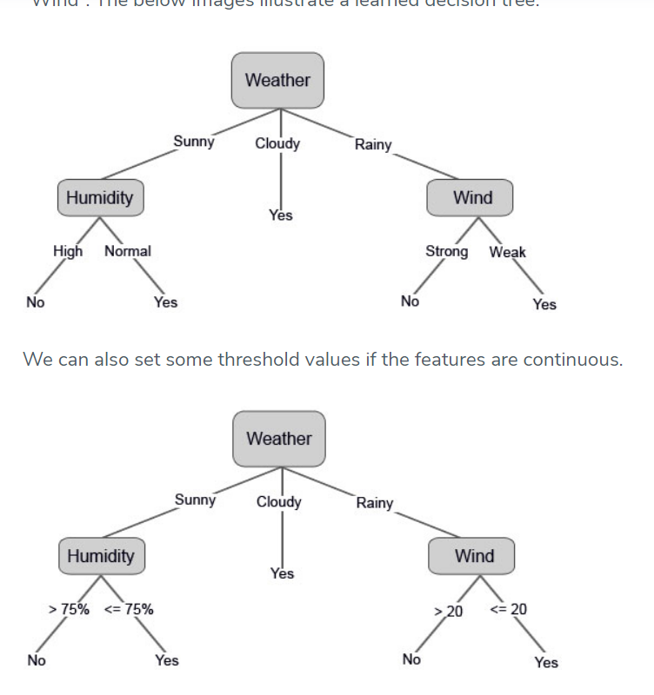
Decision Tree-Steps

Slide 14
Random Forest
Classification is the method of predicting the class of a given input data point. Classification problems are common in machine learning and they fall under the Supervised learning method.

Slide 15
Random Forest
Random forest builds multiple decision trees (called the forest) and glues them together to get a more accurate and stable prediction.
The forest it builds is a collection of Decision Trees, trained with the bagging method.

Slide 16
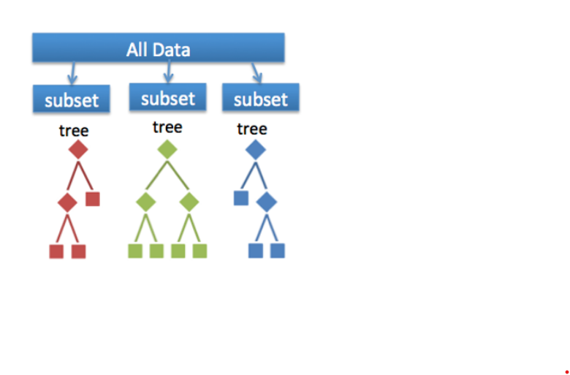
Random Forest

Slide 17
Random Forest
Price of the house
Locality
Number of bedrooms
Parking space
Available facilities

Slide 18
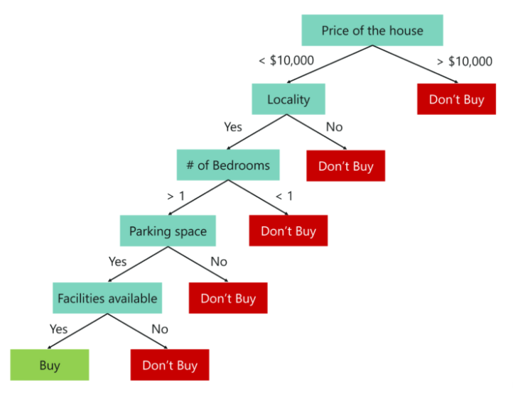
Random Forest

Slide 19
Random Forest
An important point to note here is that Decision trees are built on the entire data set,
by making use of all the predictor variables.
Now let’s see how Random Forest would solve the same problem.

Slide 20
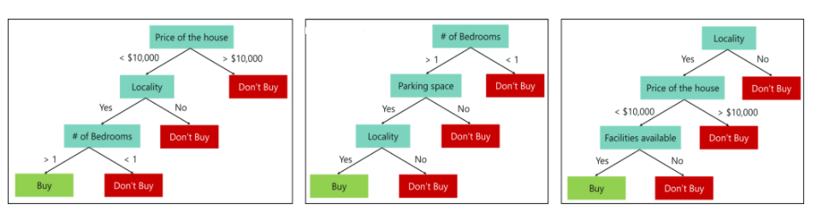
Random Forest

Slide 21
Random Forest
To conclude, Decision trees are built on the entire data set using all the predictor variables, whereas Random Forests are used to create multiple decision trees, such that each decision tree is built only on a part of the data set.

Slide 22
Random Forest
Decision trees work very effectively with the training data that was used to build them, but they’re not flexible when it comes to classifying the new sample. Which means that the accuracy during testing phase is very low.
This happens due to a process called Over-fitting.

Slide 23
Random Forest
Creating A Random Forest
Step 1: Create a Bootstrapped Data Set
Step 2: Creating Decision Trees
Step 3: Go back to Step 1 and Repeat
Step 4: Predicting the outcome of a new data point
Step 5: Evaluate the Model

Slide 24
Random Forest
Step 1: Create a Bootstrapped Data Set
Bootstrapping is an estimation method used to make predictions on a data set by re-sampling it.
To create a bootstrapped data set, we must randomly select samples from the original data set.

Slide 25
Random Forest
Step 2: Creating Decision Trees
Our next task is to build a Decision Tree by using the bootstrapped data set created in the previous step.
Few variables will be considered and start of implementation with root node

Slide 26
Gini Coefficient
Gini Coefficient is also known as the Gini index is the statistical measure which is used in order to measure the distribution

Slide 27
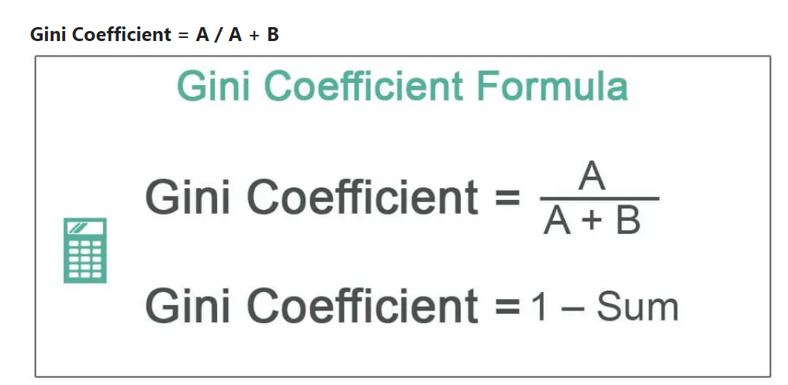
Gini Coefficient

Slide 28

Gini Coefficient
Fill ‘% of Population that is richer’ column by adding all terms in ‘Fraction of Population’ below that row.
Calculate the Score for each of the rows. The formula for Score is: Score = Fraction of Income * (Fraction of Population + 2 * % of Population that is richer).
Organize the data into a table with the category head mentioned below.

Slide 29
Gini Coefficient
Next, add all the terms in the ‘Score’ column. Let us call it ‘Sum.’
Calculate the Gini coefficient using the formula: = 1 – Sum

